Slide 1
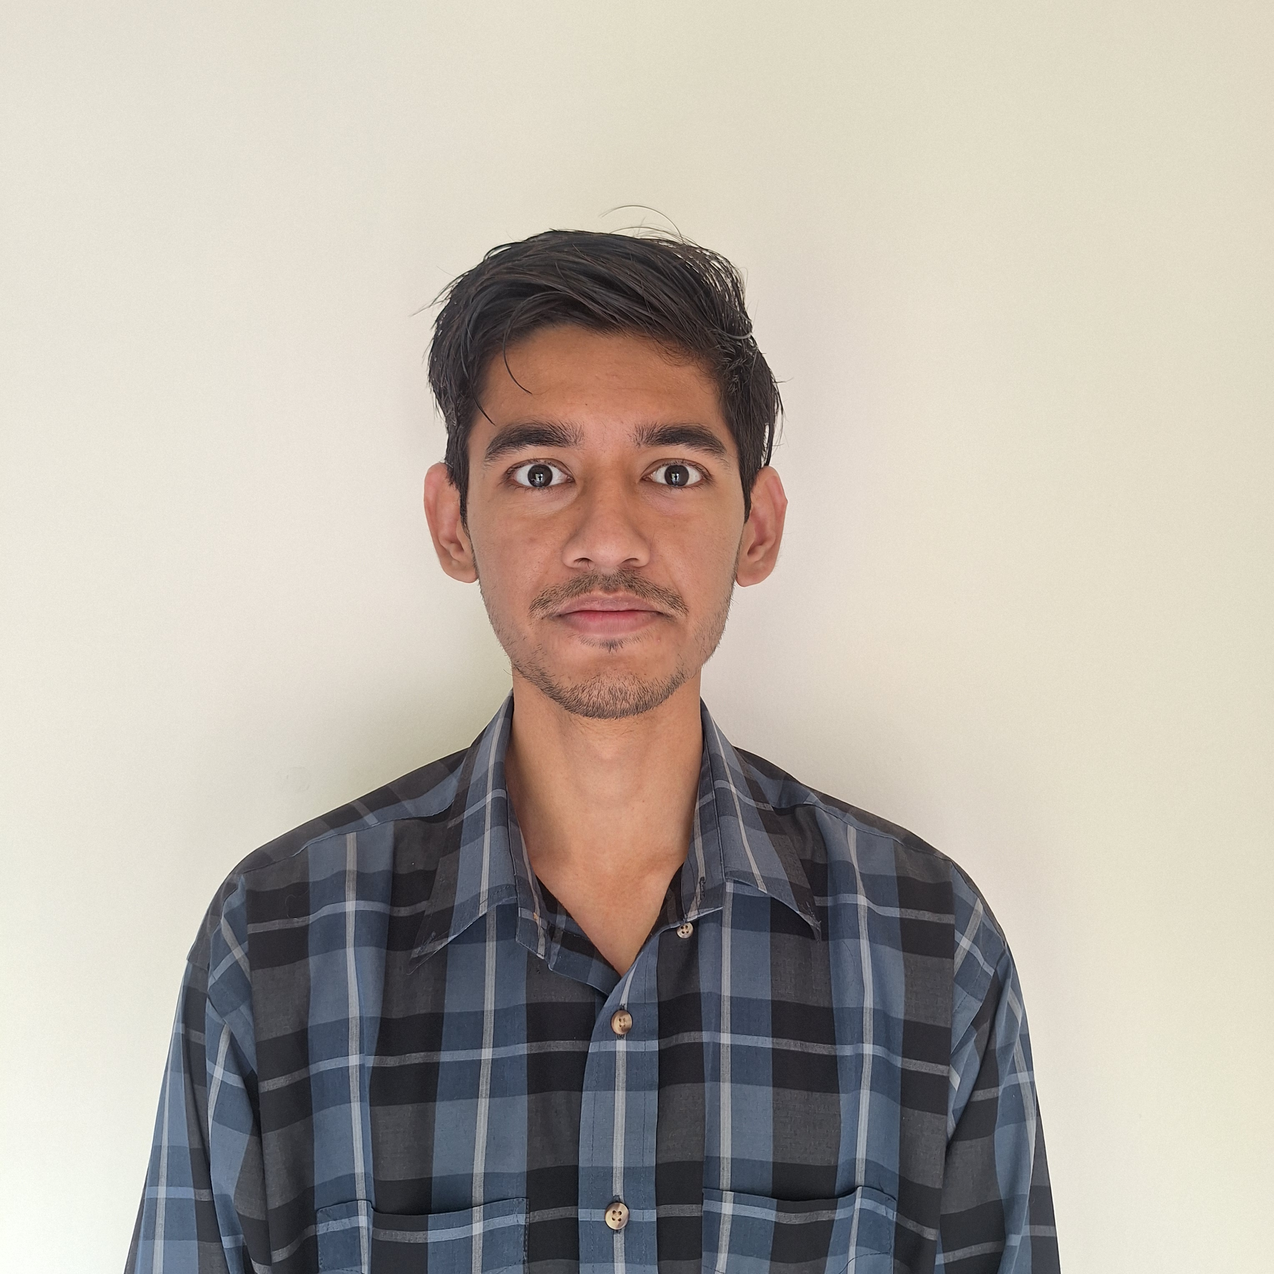

Name: Rahul Kanwal Role: Solutions Architect Intern Team: Field-AGS-UTP-All-CS
Email: rjkanwal@amazon.com
Phone: +1 (669) 319-9828
LinkedIn: linkedin.com/in/rahul-kanwal

Slide 2
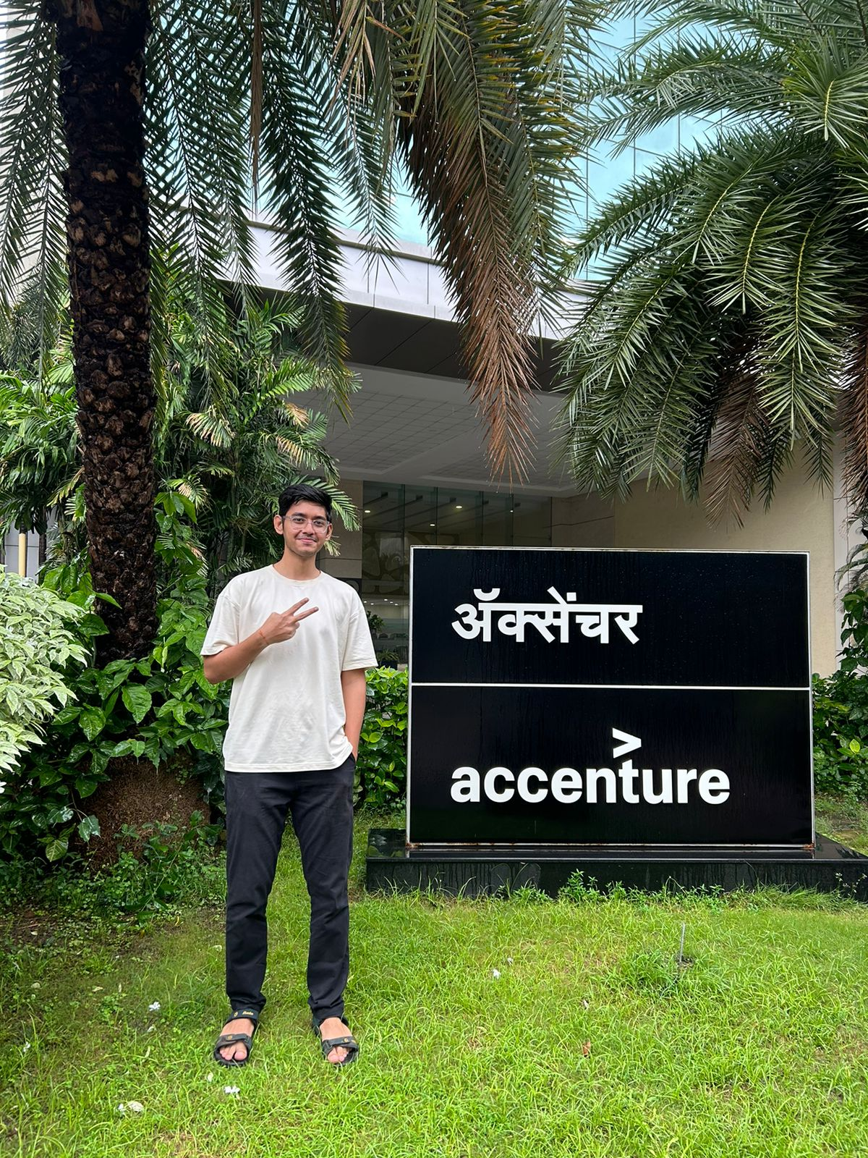
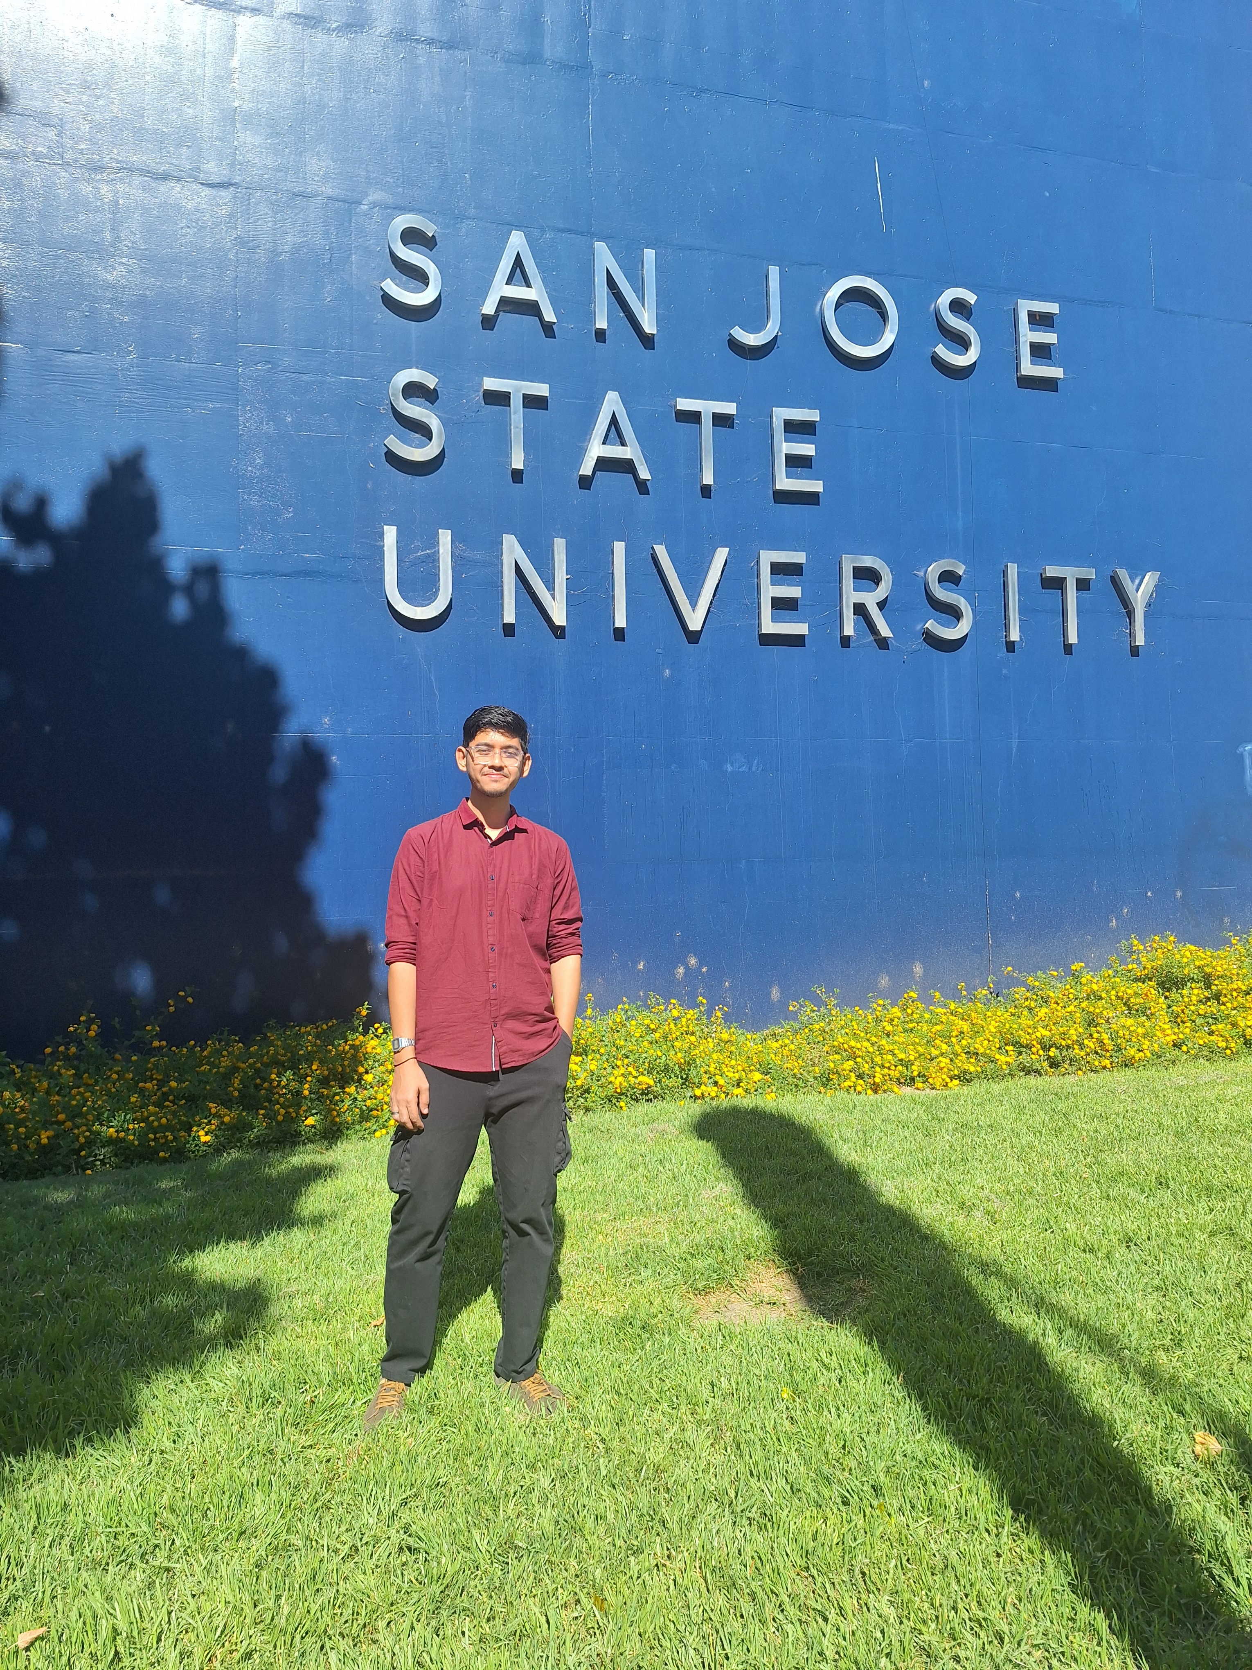
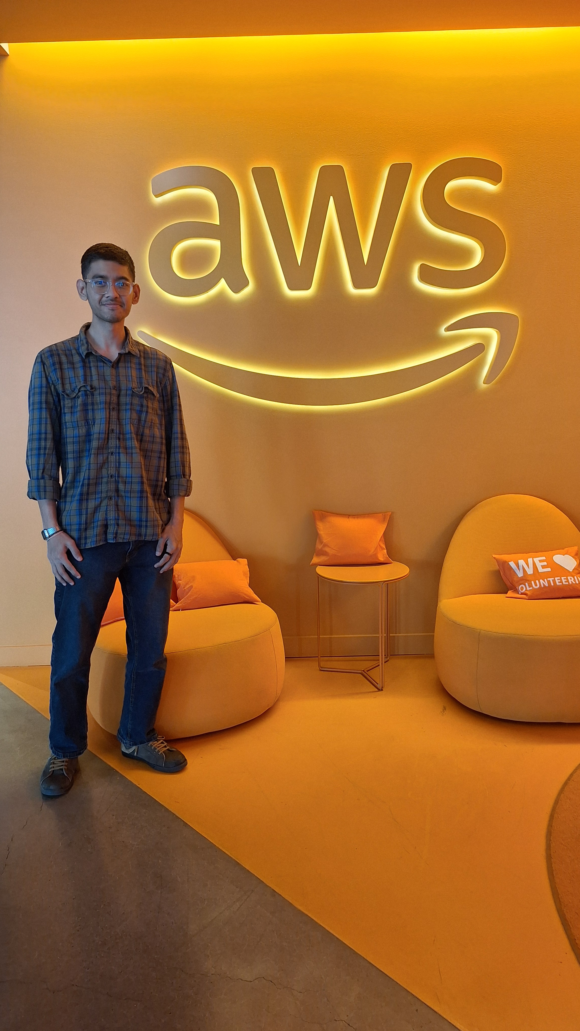
Background
From Mumbai, India
MS in Software Engineering at San Jose State University
3 Years at Accenture
.NET, Angular, Azure Cloud Services

Slide 3
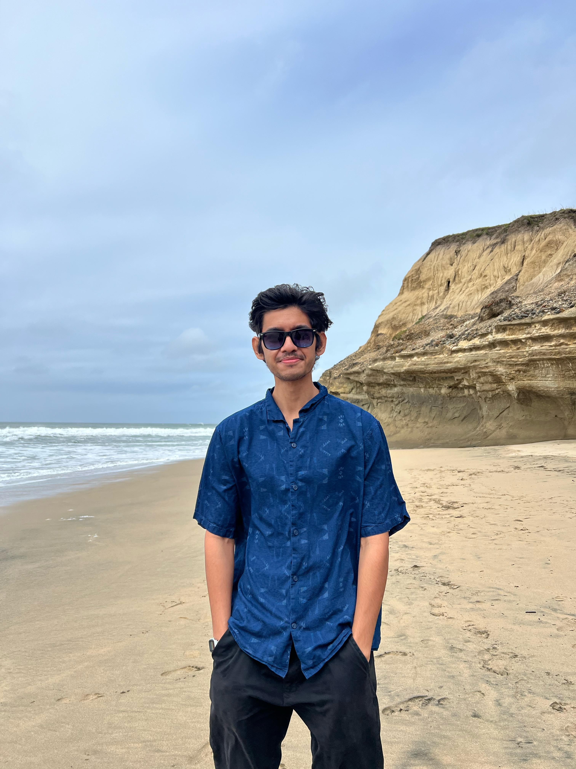
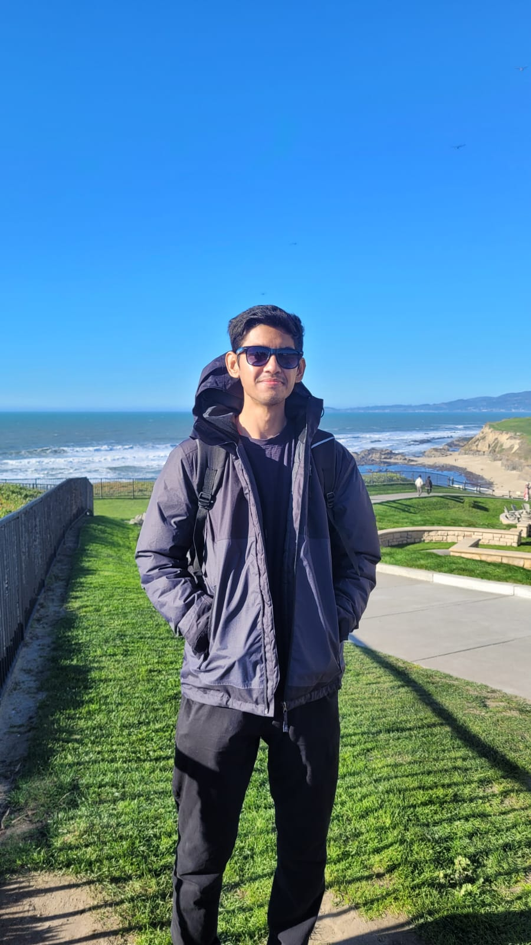
About Me
Likes Traveling and Hiking
Gym(can finally do a pull-up :D)
Reading(currently in my 2nd book of the year)
Play and follow Cricket
Have 2 cats

Slide 4
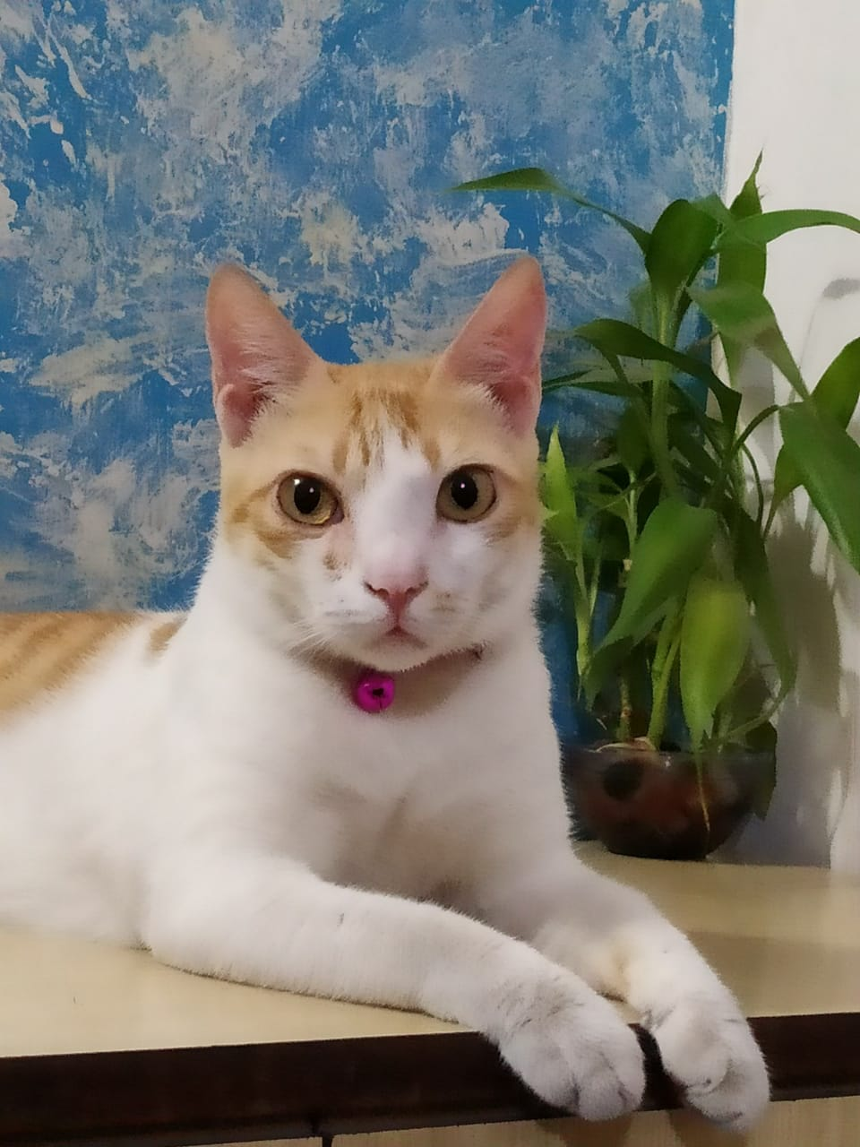
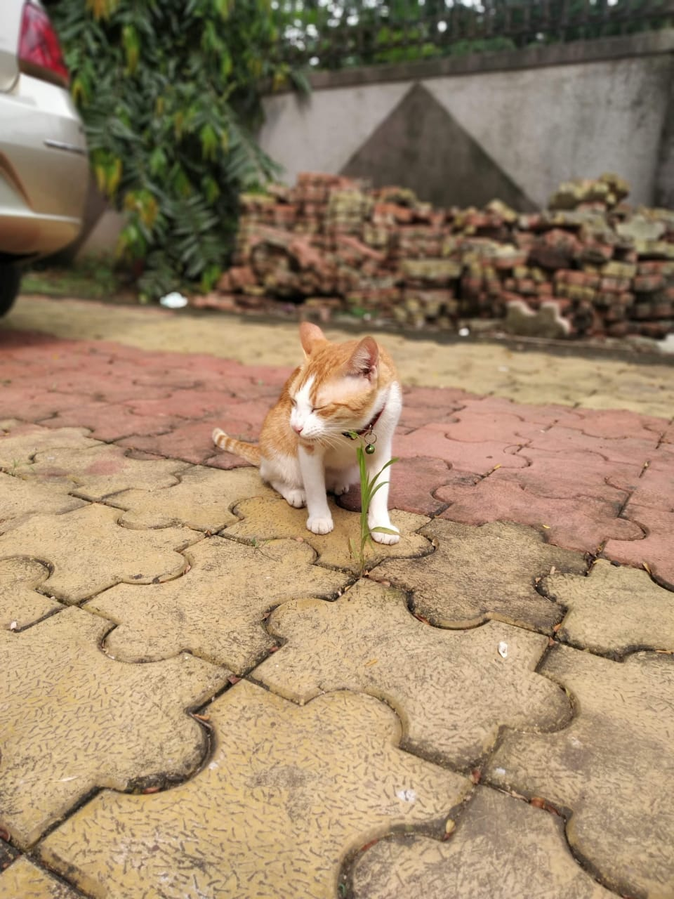

Slide 5
Thank You :D

